Slide 1

EMG DECOMPOSITION
Mateo Umaguing

Slide 2
INTRODUCTION
EMG decomposition is a signal processing method that decomposes an EMG signal into constituent motor unit action potentials (MUAPs) and classifies such MUAPs to individual motor units (MUs). We shall explore an analysis pipeline that aims to apply EMG decomposition to three separate EMG inputs.

Slide 3
METHODOLOGY
Input file
Bandpass filter signal
Detect spikes with threshold
Align spikes to peak
Extract features using dimensionality reduction
Cluster spikes with K-means clustering
Classify spikes
Analyze spikes

Slide 4
EMG Example 1, Channel 2

Slide 5
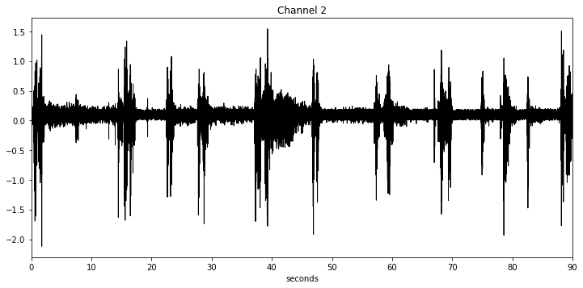
INPUT FILE – SAMPLED AT 2000 HZ

Slide 6
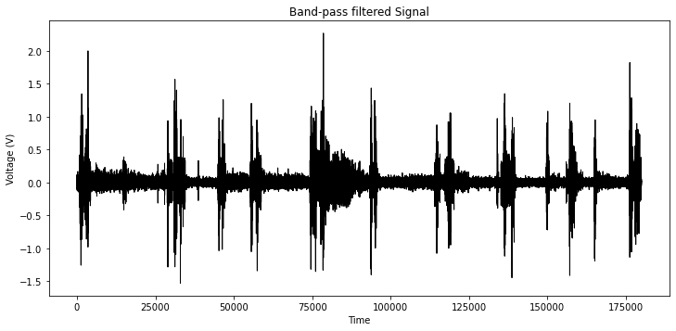
BANDPASS FILTER SIGNAL
Our selected passband is 20-500Hz. This was carefully selected to filter out movement artifacts at high frequencies and slow EMG waveforms at low frequencies.

Slide 7
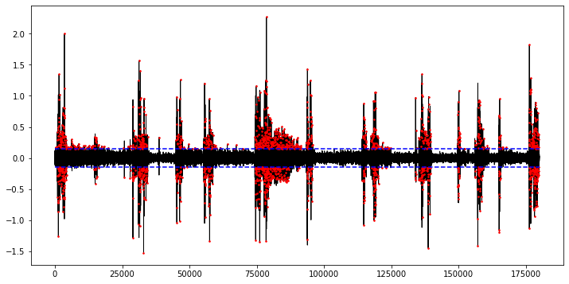
DETECT SPIKES WITH THRESHOLD
We will use a threshold based on an estimation of the signal noise in order to detect peaks. Any peak above this threshold will be considered a spike.

Slide 8
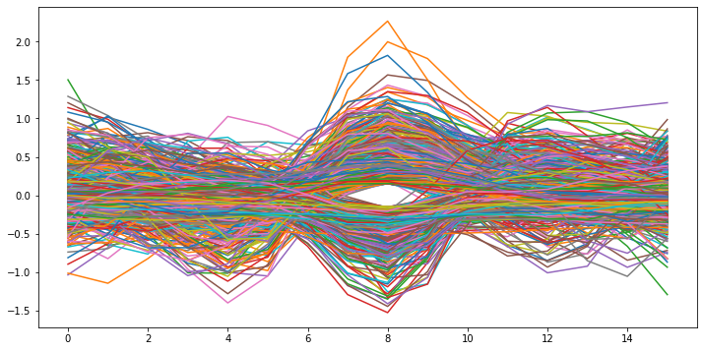
ALIGN SPIKES TO PEAK
A window of length of 16 samples (8 ms) around each spike will be considered a MUAP, each of which will be saved into a n x 16 matrix of MUAPs.

Slide 9
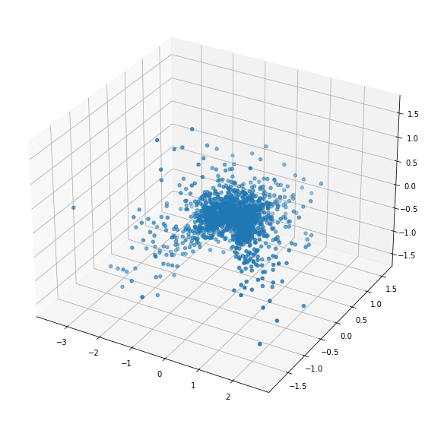
EXTRACT FEATURES WITH DIMENSIONALITY REDUCTION
We will then apply PCA to the matrix of MUAPs to get a 3 x 16 matrix, and for each MUAP, compute the PC coefficients. Each coefficient will be defined as the dot product of a principal component (1 x 16) and the MUAP.

Slide 10
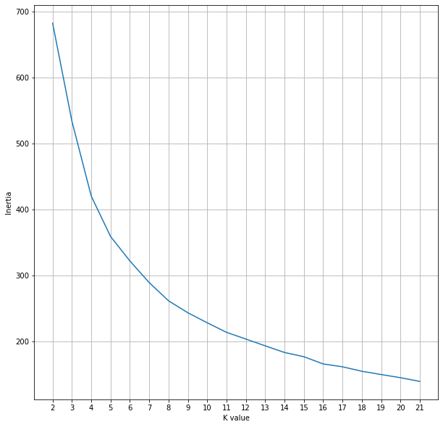
CLUSTER SPIKES WITH K-MEANS CLUSTERING
Next, we will cluster the spikes. The number of clusters will be the number of MUs, therefore we will choose k by observing the cost for different values of k. The best values are where an ‘elbow’ appears.

Slide 11
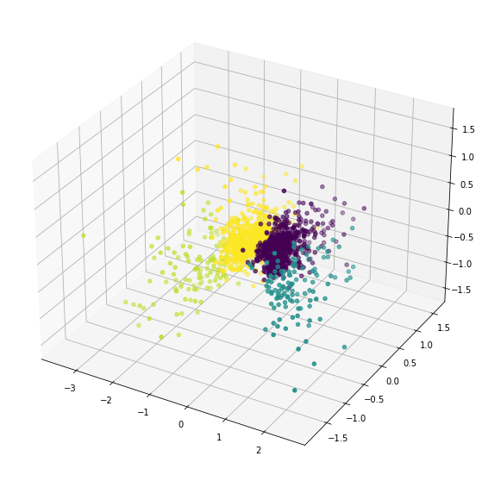
CLUSTER SPIKES WITH K-MEANS CLUSTERING
An elbow formed at k = 4, therefore we shall use 4-means clustering.

Slide 12
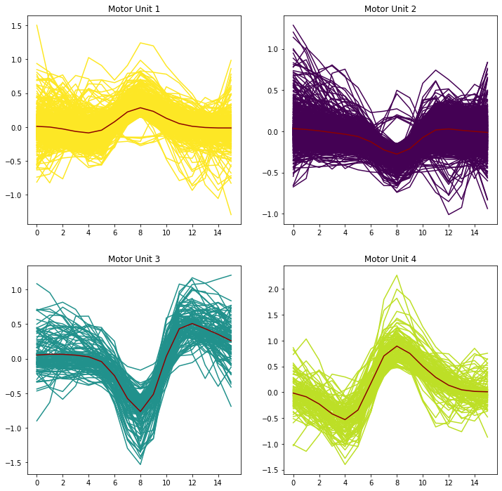
CLASSIFY SPIKES
We will look at the average spike for each cluster and plot every spike within the cluster.

Slide 13
CLASSIFY SPIKES
We will look at the average spike for each cluster and plot every spike within the cluster.

Slide 14

ANALYZE SPIKES
Here is the firing rate of each MU:

Slide 15
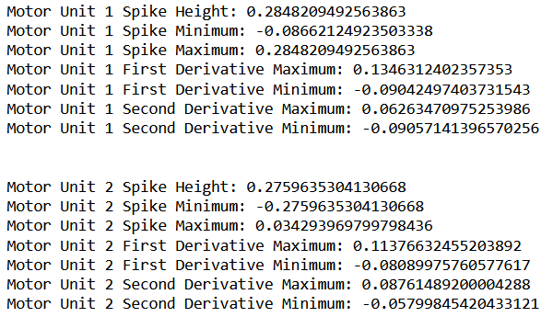
ANALYZE SPIKES
For each MUAP average, we can observe the spike height and minima and maxima for first and second derivatives.

Slide 16
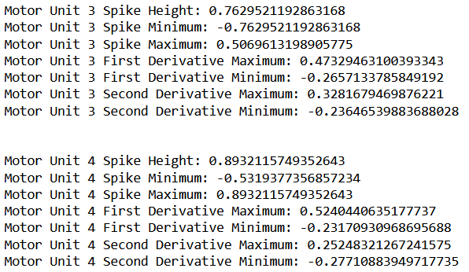
ANALYZE SPIKES
For each MUAP average, we can observe the spike height and minima and maxima for first and second derivatives.

Slide 17
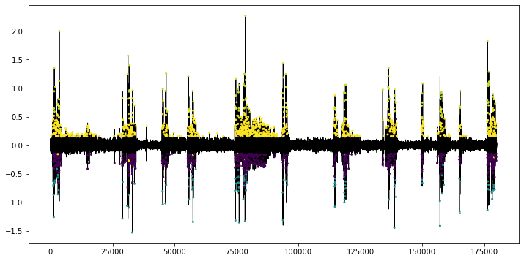
ANALYZE SPIKES
We can also observe where each MU fires throughout the entire EMG signal.

Slide 18
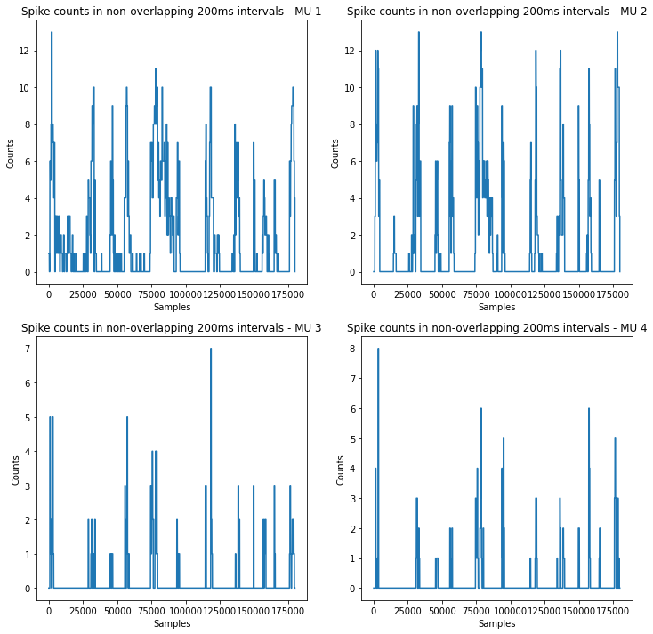
ANALYZE SPIKES
Here are the spike histograms – the counts of spikes within non-overlapping 200ms intervals across the EMG signal.

Slide 19
ANALYZE SPIKES
Here are the spike histograms – the counts of spikes within non-overlapping 200ms intervals across the EMG signal.

Slide 20
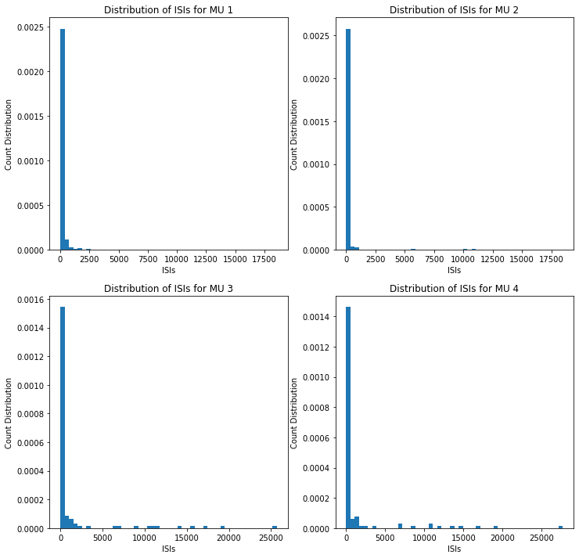
ANALYZE SPIKES
Lastly, we can observe the interspike intervals (ISIs), or time in between spikes.

Slide 21
ANALYZE SPIKES
Lastly, we can observe the interspike intervals (ISIs), or time in between spikes.

Slide 22

ANALYZE SPIKES
Lastly, we can observe the interspike intervals (ISIs), or time in between spikes.

Slide 23
EMG Example 2, Channel 4

Slide 24
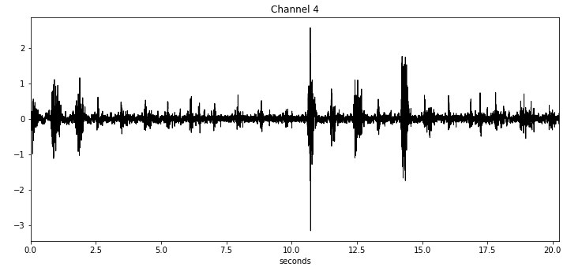
INPUT FILE – SAMPLED AT 2000 HZ

Slide 25
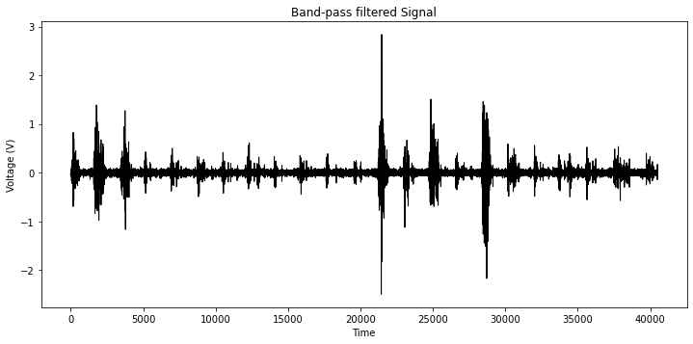
BANDPASS FILTER SIGNAL
Our selected passband is 20-500Hz. This was carefully selected to filter out movement artifacts at high frequencies and slow EMG waveforms at low frequencies.

Slide 26
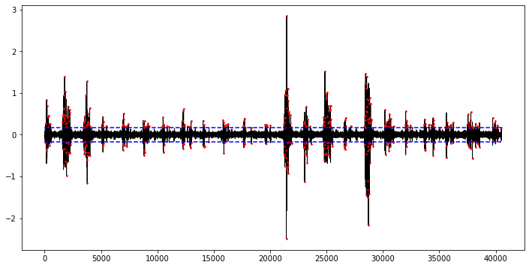
DETECT SPIKES WITH THRESHOLD
We will use a threshold based on an estimation of the signal noise in order to detect peaks. Any peak above this threshold will be considered a spike.

Slide 27
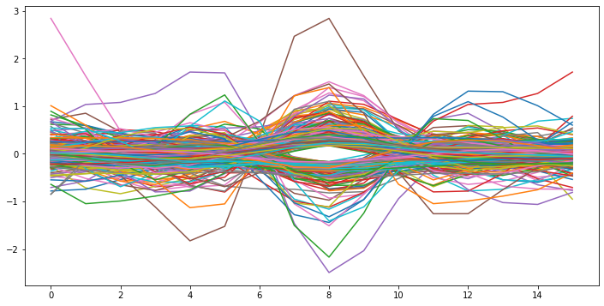
ALIGN SPIKES TO PEAK
A window of length of 16 samples (8 ms) around each spike will be considered a MUAP, each of which will be saved into a n x 16 matrix of MUAPs.

Slide 28
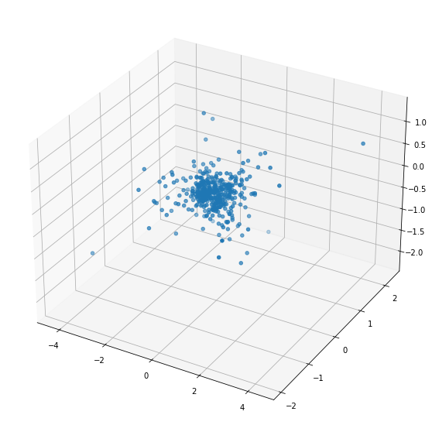
EXTRACT FEATURES WITH DIMENSIONALITY REDUCTION
We will then apply PCA to the matrix of MUAPs to get a 3 x 16 matrix, and for each MUAP, compute the PC coefficients. Each coefficient will be defined as the dot product of a principal component (1 x 16) and the MUAP.

Slide 29
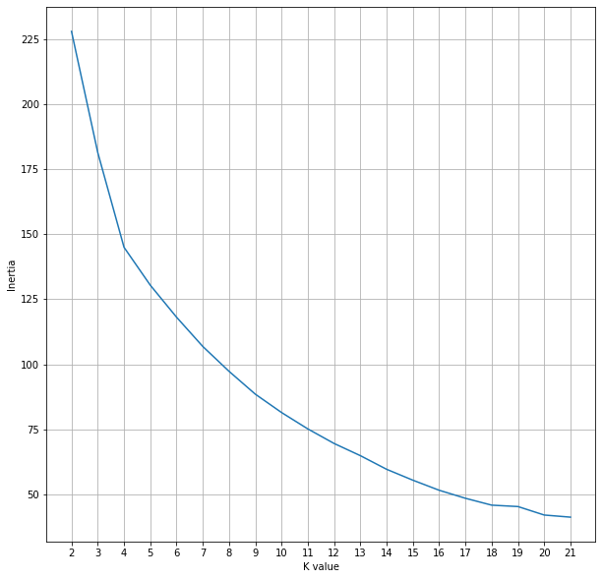
CLUSTER SPIKES WITH K-MEANS CLUSTERING
Next, we will cluster the spikes. The number of clusters will be the number of MUs, therefore we will choose k by observing the cost for different values of k. The best values are where an ‘elbow’ appears.

Slide 30
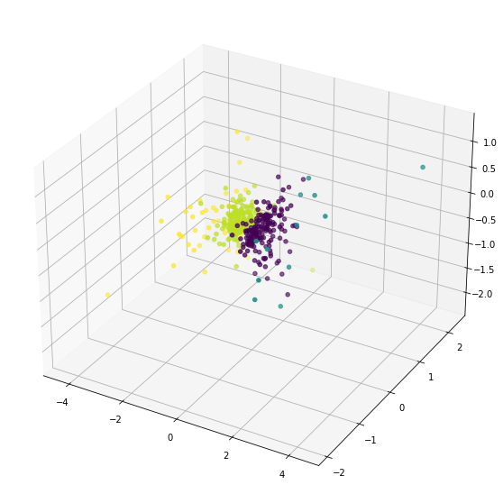
CLUSTER SPIKES WITH K-MEANS CLUSTERING
An elbow formed at k = 4, therefore we shall use 4-means clustering.

Slide 31
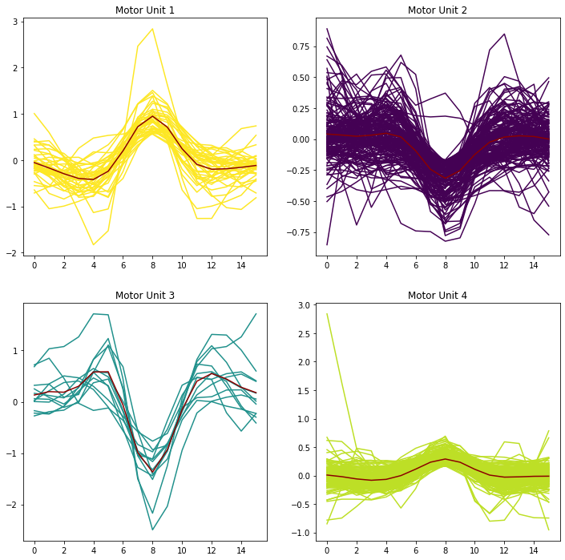
CLASSIFY SPIKES
We will look at the average spike for each cluster and plot every spike within the cluster.

Slide 32
CLASSIFY SPIKES
We will look at the average spike for each cluster and plot every spike within the cluster.

Slide 33

ANALYZE SPIKES
Here is the firing rate of each MU:

Slide 34
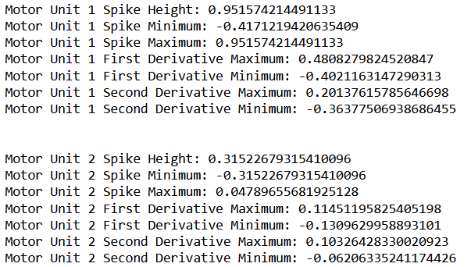
ANALYZE SPIKES
For each MUAP average, we can observe the spike height and minima and maxima for first and second derivatives.

Slide 35
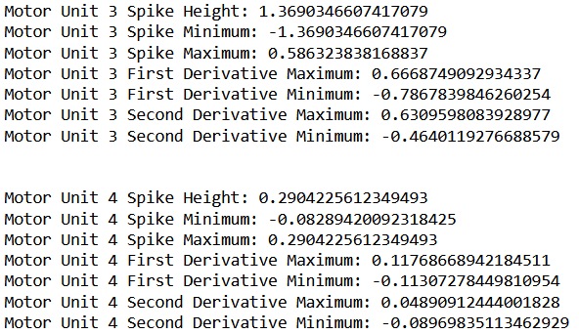
ANALYZE SPIKES
For each MUAP average, we can observe the spike height and minima and maxima for first and second derivatives.

Slide 36
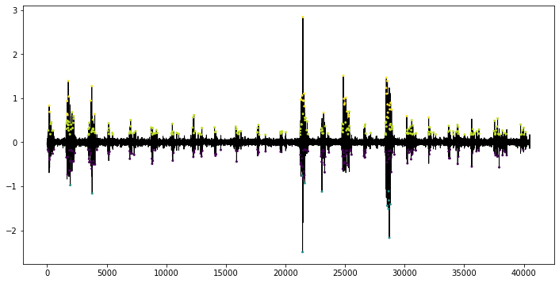
ANALYZE SPIKES
We can also observe where each MU fires throughout the entire EMG signal.

Slide 37
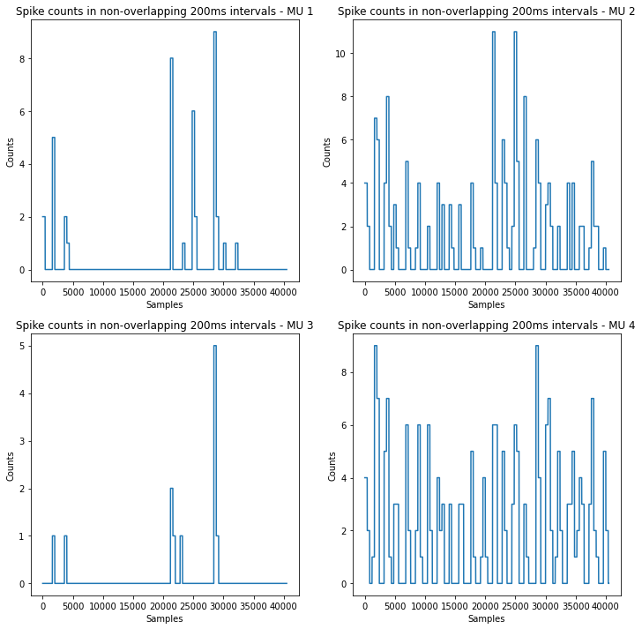
ANALYZE SPIKES
Here are the spike histograms – the counts of spikes within non-overlapping 200ms intervals across the EMG signal.

Slide 38
ANALYZE SPIKES
Here are the spike histograms – the counts of spikes within non-overlapping 200ms intervals across the EMG signal.

Slide 39
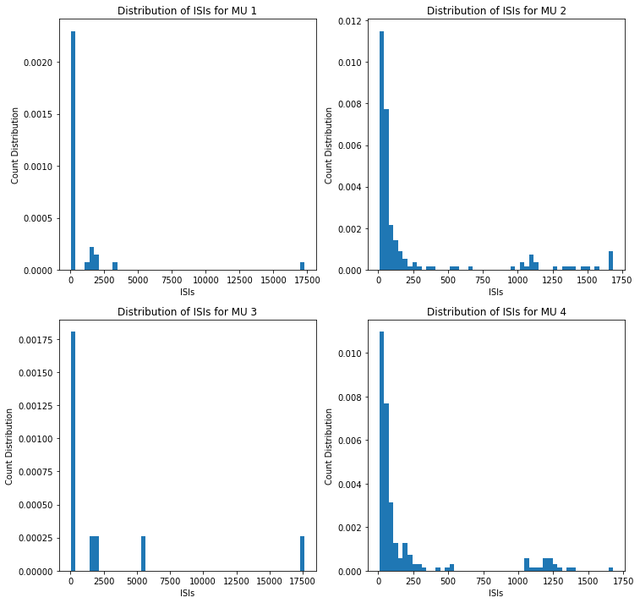
ANALYZE SPIKES
Lastly, we can observe the interspike intervals (ISIs), or time in between spikes.

Slide 40
ANALYZE SPIKES
Lastly, we can observe the interspike intervals (ISIs), or time in between spikes.

Slide 41

ANALYZE SPIKES
Lastly, we can observe the interspike intervals (ISIs), or time in between spikes.

Slide 42
EMG Example 20s, Channel 1

Slide 43
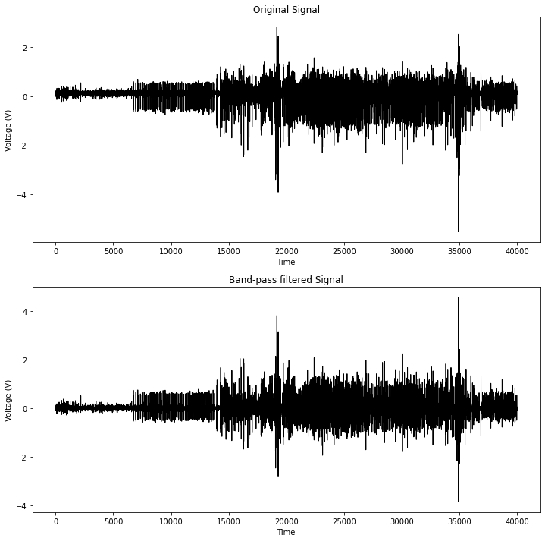
INPUT FILE – SAMPLED AT 2000 HZ

Slide 44
BANDPASS FILTER SIGNAL
Our selected passband is 20-500Hz. This was carefully selected to filter out movement artifacts at high frequencies and slow EMG waveforms at low frequencies.

Slide 45
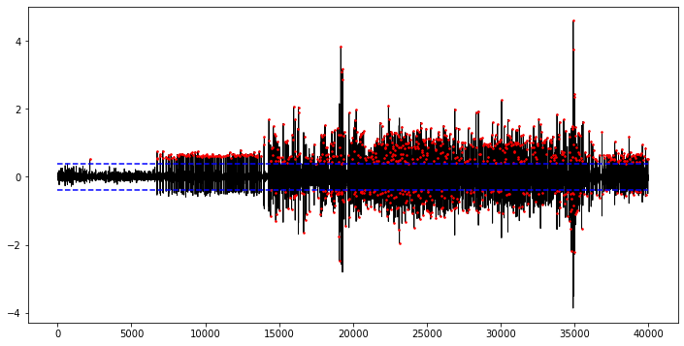
DETECT SPIKES WITH THRESHOLD
We will use a threshold based on an estimation of the signal noise in order to detect peaks. Any peak above this threshold will be considered a spike.

Slide 46
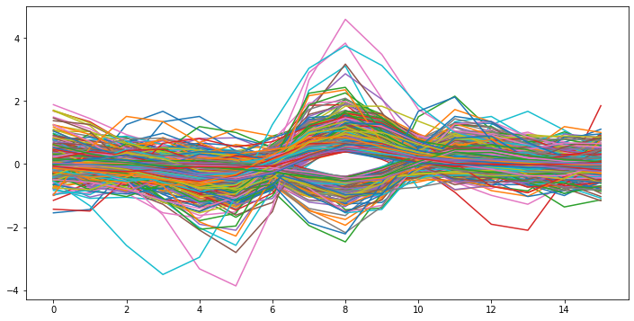
ALIGN SPIKES TO PEAK
A window of length of 16 samples (8 ms) around each spike will be considered a MUAP, each of which will be saved into a n x 16 matrix of MUAPs.

Slide 47
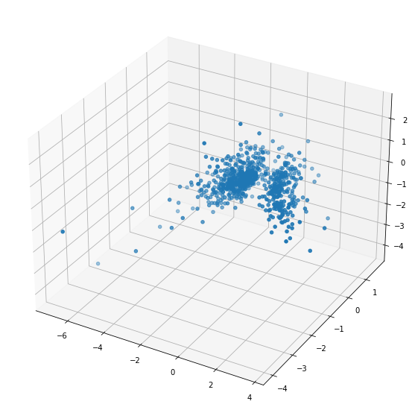
EXTRACT FEATURES WITH DIMENSIONALITY REDUCTION
We will then apply PCA to the matrix of MUAPs to get a 3 x 16 matrix, and for each MUAP, compute the PC coefficients. Each coefficient will be defined as the dot product of a principal component (1 x 16) and the MUAP.

Slide 48
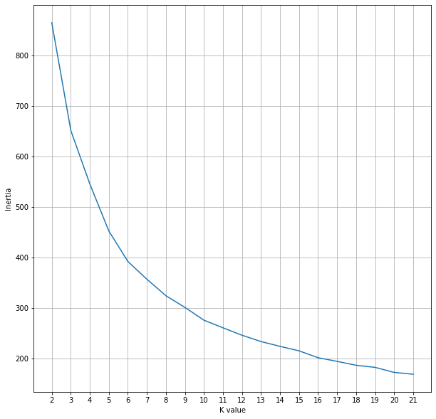
CLUSTER SPIKES WITH K-MEANS CLUSTERING
Next, we will cluster the spikes. The number of clusters will be the number of MUs, therefore we will choose k by observing the cost for different values of k. The best values are where an ‘elbow’ appears.

Slide 49
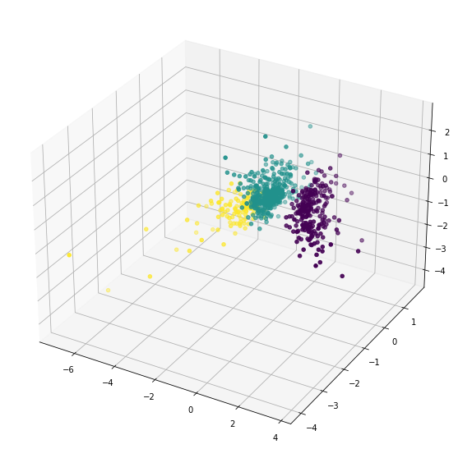
CLUSTER SPIKES WITH K-MEANS CLUSTERING
An elbow formed at k = 3, therefore we shall use 3-means clustering.

Slide 50
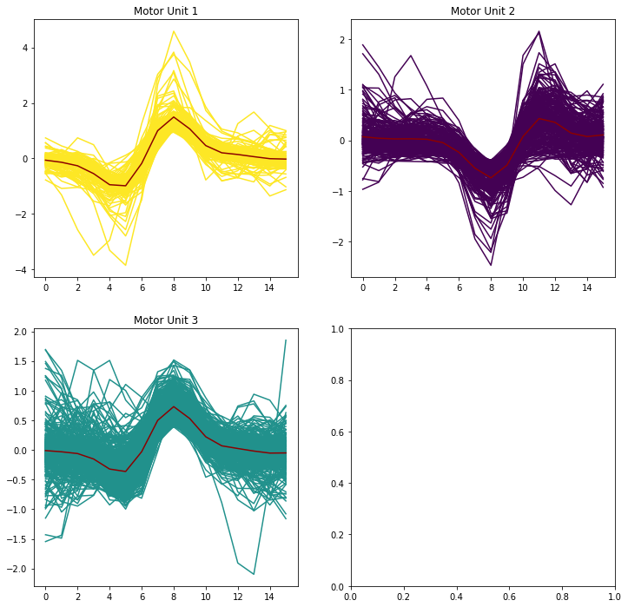
CLASSIFY SPIKES
We will look at the average spike for each cluster and plot every spike within the cluster.

Slide 51
CLASSIFY SPIKES
We will look at the average spike for each cluster and plot every spike within the cluster.

Slide 52
ANALYZE SPIKES
Here is the firing rate of each MU:

Slide 53
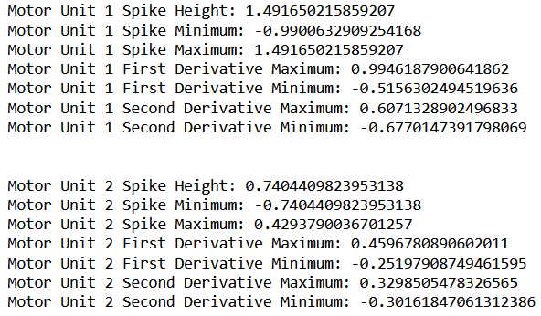
ANALYZE SPIKES
For each MUAP average, we can observe the spike height and minima and maxima for first and second derivatives.

Slide 54
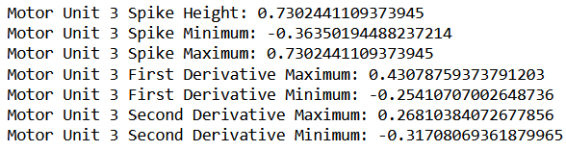
ANALYZE SPIKES
For each MUAP average, we can observe the spike height and minima and maxima for first and second derivatives.

Slide 55
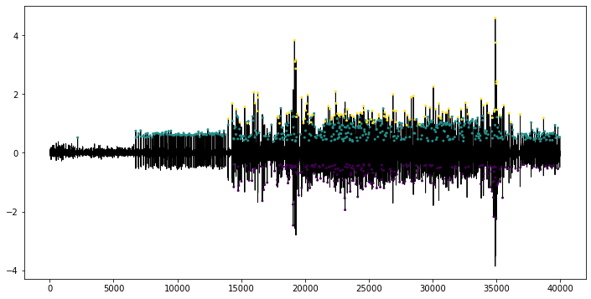
ANALYZE SPIKES
We can also observe where each MU fires throughout the entire EMG signal.

Slide 56
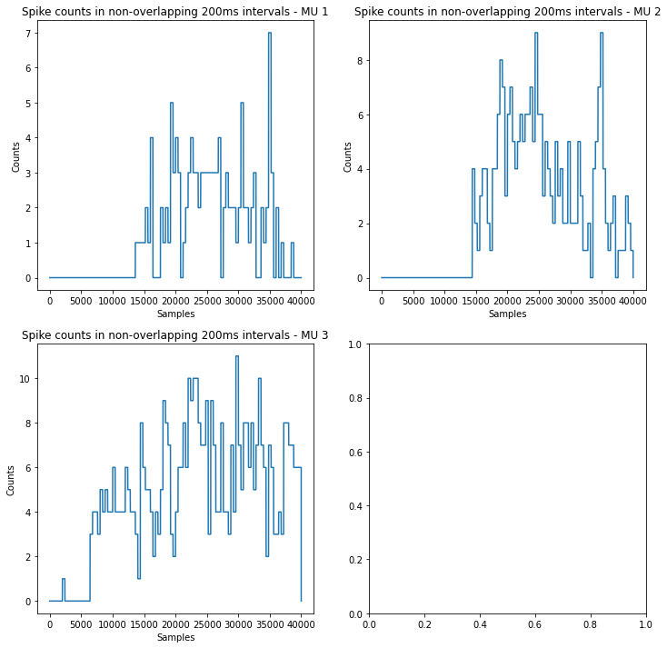
ANALYZE SPIKES
Here are the spike histograms – the counts of spikes within non-overlapping 200ms intervals across the EMG signal.

Slide 57
ANALYZE SPIKES
Here are the spike histograms – the counts of spikes within non-overlapping 200ms intervals across the EMG signal.

Slide 58
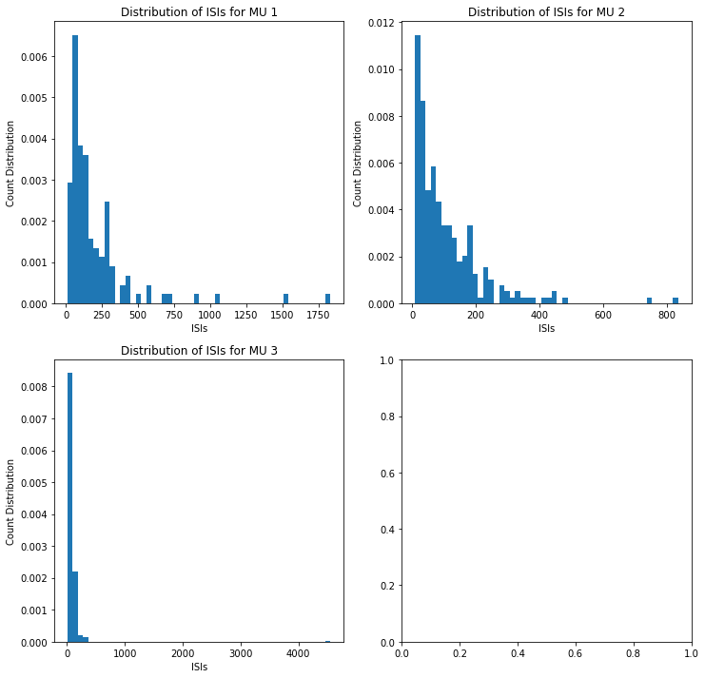
ANALYZE SPIKES
Lastly, we can observe the interspike intervals (ISIs), or time in between spikes.

Slide 59
ANALYZE SPIKES
Lastly, we can observe the interspike intervals (ISIs), or time in between spikes.

Slide 60

ANALYZE SPIKES
Lastly, we can observe the interspike intervals (ISIs), or time in between spikes.

